Slide 1



Deep Learning 101 mlhep 2019

Slide 2
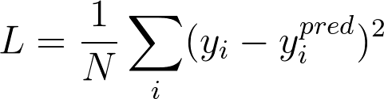
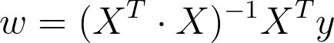
Linear Regression
Model:
Objective function:
Optimization (exact):
pred
x
wx +b
y

Slide 3
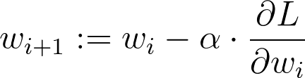
Linear Regression
Model:
Objective function:
Optimization (iterative):
pred
x
wx +b
y

Slide 4
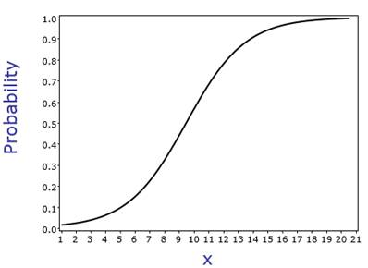
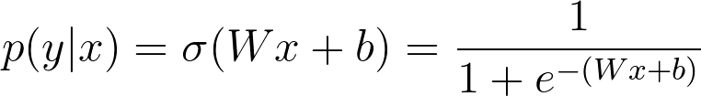
Logistic Regression
X
wx +b
p(y|x)
Objective function ?

Slide 5
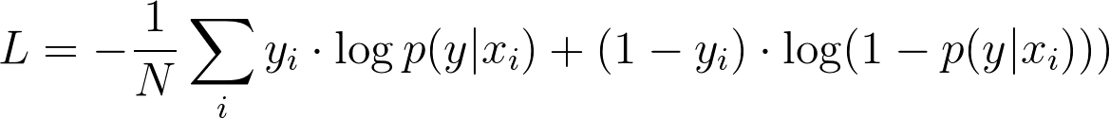
Logistic Regression
Model:
Objective function:
Optimization(iterative): same as linear regression
X
wx +b
P(y)

Slide 6
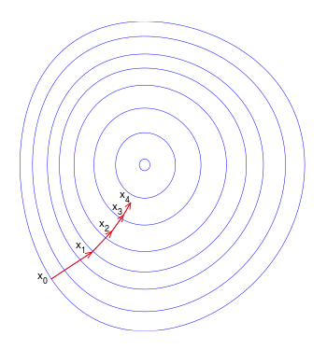
Recap: Gradient Descent
Update:
a – learning rate a<<1
L – loss function

Slide 7
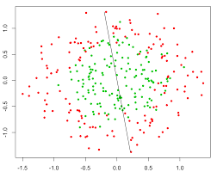
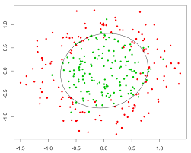
Nonlinear dependencies
What we have What we want
How to learn that?

Slide 8
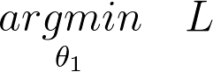
Feature extraction
Loss: same as linear/logistic regression
Model:
Feature
Extractor
(manual)
Classifier
Ɵ1~W,b
X
Prediction
Training:

Slide 9

What if...
Features would tune to your problem automagically!

Slide 10
What do we want, exactly?
Model:
Feature
Extractor
Ɵ2
Classifier
Ɵ1~W,b
X
Prediction
?
Objective:

Slide 11
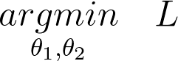
What do we want, exactly?
Model:
Feature
Extractor
Ɵ2
Classifier
Ɵ1~W,b
X
Prediction
Joint training:

Slide 12
Okay, how do we extract features?

Slide 13
Try linear
Model:
Linear
model
Logistic
Regres-
sion
X
Prediction

Slide 14
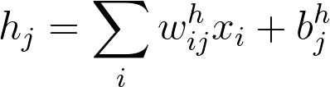
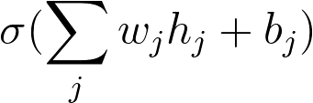
Try linear
Model:
Linear
model
Logistic
Regres-
sion
X
Prediction

Slide 15
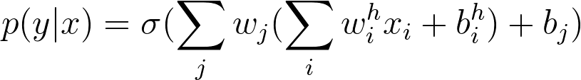
Try linear
Model:
Linear
model
Logistic
Regres-
sion
X
Prediction
Output:
Is it any better than logistic regression?

Slide 16
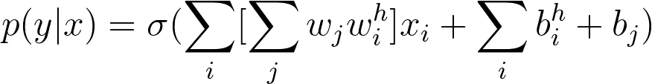
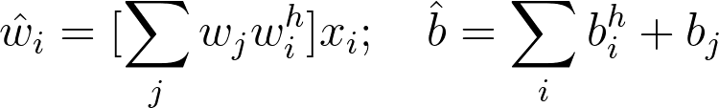
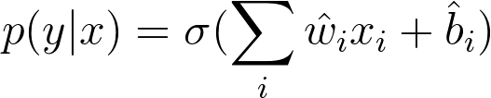
Try linear

Slide 17
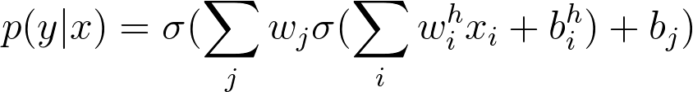
Add nonlinearity
Model:
Linear
model
σ(h)
Logistic
Regres-
sion
X
Prediction

Slide 18
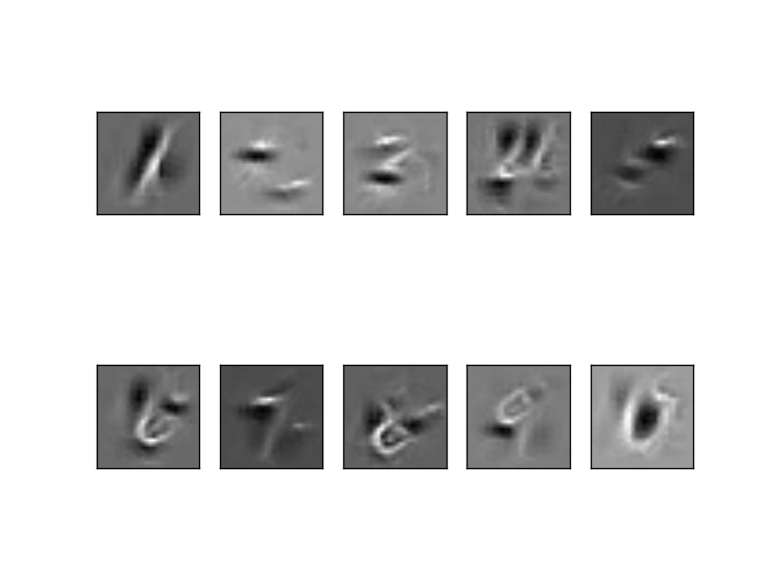
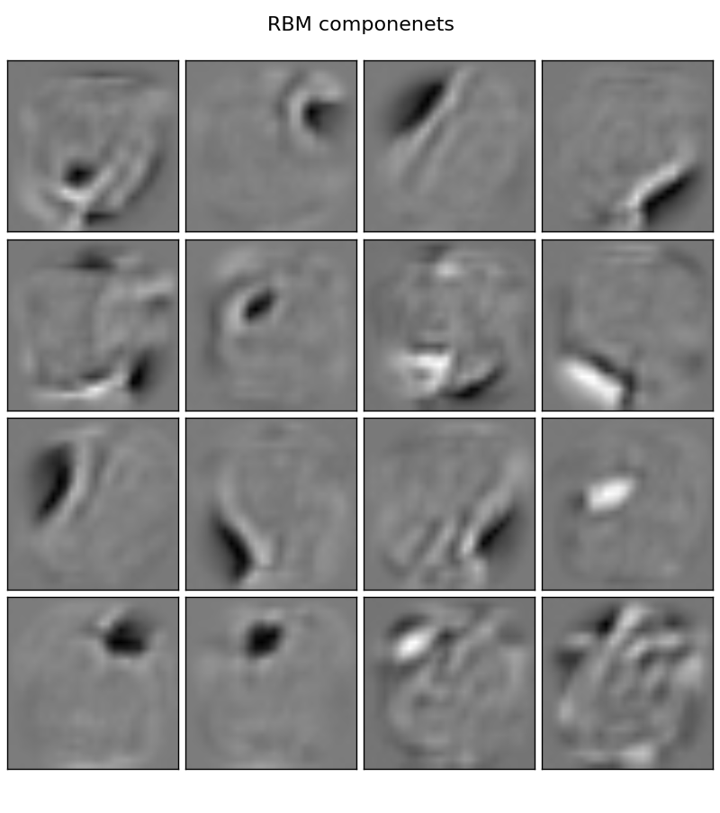
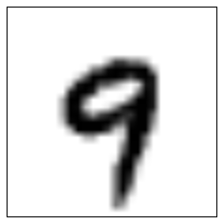
Add nonlinearity
Model:
Linear
model
σ(h)
Logistic
Regres-
sion
X
Prediction
P(“1”)
P(“2”)
...
P(“9”)

Slide 19
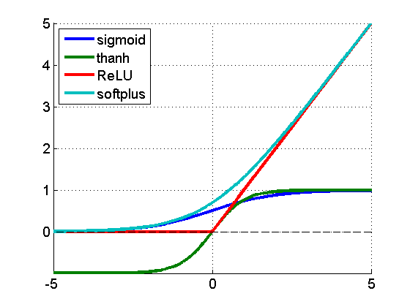
Add nonlinearity
f(a) = 1/(1+e^a)
f(a) = tanh(a)
f(a) = max(0,a)
f(a) = log(1+e^a)
f(a)
a

Slide 20
Training the monster
Model:
Linear
model
σ(h)
Logistic
Regres-
sion
X
Prediction
Output:
Training: ?!

Slide 21
Training the monster
Model:
Linear
model
σ(h)
Logistic
Regres-
sion
X
Prediction
Output:
Training: gradient descent!

Slide 22
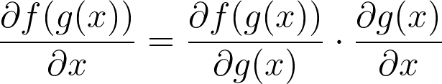
Backpropagation
TL;DR: backprop = chain rule*

Slide 23

Backpropagation
TL;DR: backprop = chain rule*
* g and x can be vectors/vectors/tensors

Slide 24
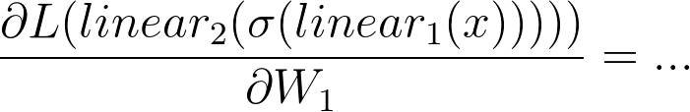
Backpropagation
linear
h units
W1,b1
σ(h)
linear
1 unit
W2,b2
σ(h)
X
Prediction
Y
L

Slide 25
Backpropagation
linear
h units
W1,b1
σ(h)
linear
1 unit
W2,b2
σ(h)
X
Prediction
Y
L

Slide 26
Backpropagation
linear
h units
W1,b1
σ(h)
linear
1 unit
W2,b2
σ(h)
X
Prediction
Y
L

Slide 27
Backpropagation
linear
h units
W1,b1
σ(h)
linear
1 unit
W2,b2
σ(h)
X
Prediction
Y
L

Slide 28
Backpropagation
linear
h units
W1,b1
σ(h)
linear
1 unit
W2,b2
σ(h)
X
Prediction
Y
L

Slide 29
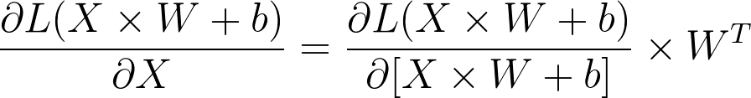


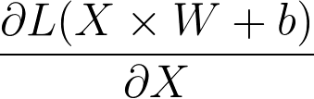
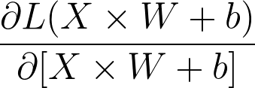
Matrix derivatives
Let’s compute:
What?
Variable shapes:
[batch size, features]
[features, outputs]
[outputs]
[batch size, features]
[batch size, outputs]

Slide 30
Matrix derivatives
Hint: 1. figure out scalar case,
2. match shapes for matrices
Let’s compute:
What?
Variable shapes:
[batch size, features]
[features, outputs]
[outputs]
[batch size, features]
[batch size, outputs]

Slide 31
Matrix derivatives
Let’s compute:
Variable shapes:
[batch size, features]
[features, outputs]
[outputs]
[batch size, features]
[batch size, outputs]

Slide 32
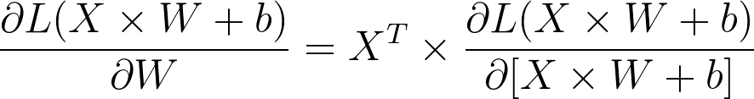
Matrix derivatives
Let’s compute:
What?
Variable shapes:
[batch size, features]
[features, outputs]
[outputs]
[batch size, features]
[batch size, outputs]

Slide 33
Matrix derivatives
Let’s compute:
Variable shapes:
[batch size, features]
[features, outputs]
[outputs]
[batch size, features]
[batch size, outputs]

Slide 34
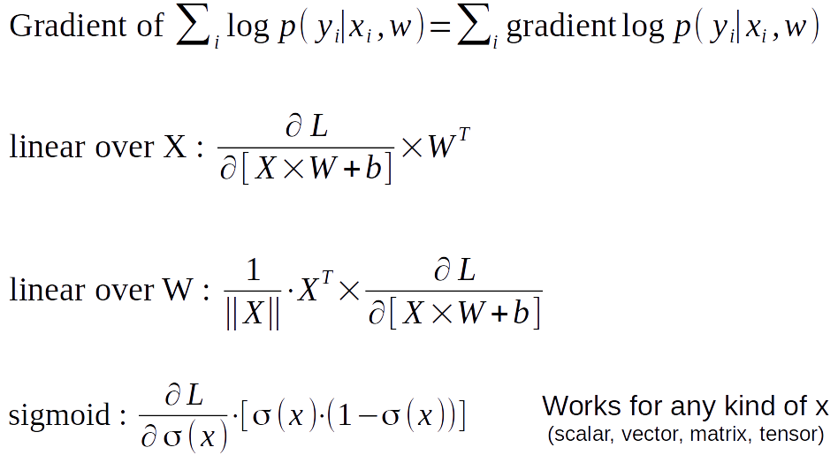
Cheat sheet for seminar

Slide 35
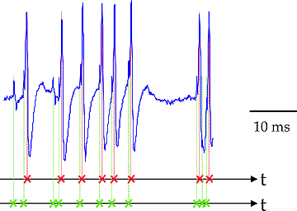
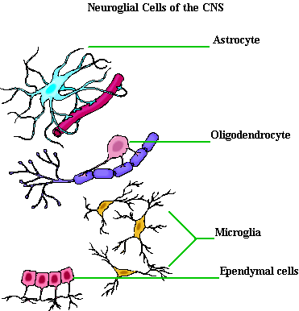
Not actual neurons :)
Neurons output in “spikes”, not real numbers
No one knows for sure how they “train”
There are other cell types
e.g. neuroglial cells

Slide 36
Connectionist phrasebook
Layer – a building block for NNs :
“Dense layer”: f(x) = Wx+b
“Nonlinearity layer”: f(x) = σ(x)
Input layer, output layer
A few more we gonna cover later
Activation – layer output
i.e. some intermediate signal in the NN
Backpropagation – a fancy word for “chain rule”

Slide 37

Connectionist phrasebook
“Train it via backprop!”

Slide 38

Connectionist phrasebook
How do we train it?

Slide 39
Potential caveats?

Slide 40
Problems with deep learning
Hardcore overfitting
No “golden standard” for architecture
Computationally heavy

Slide 41

Back to neural networks
Model:
linear
h units
W1,b1
σ(h)
linear
1 unit
W2,b2
σ(h)
X
Prediction
Training: see the demo

Slide 42
Gradient Descent
Update:
a – learning rate a<<1
L – loss function
Can we do better?

Slide 43
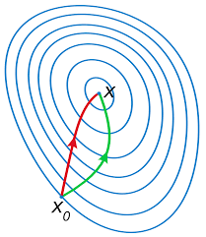
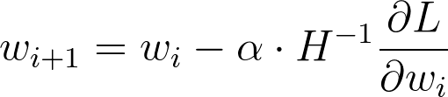
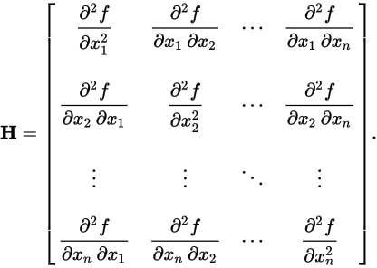
Newton-Raphson
Parameter update
Hessian:
Green: Gradient Descent Red: Newton-Raphson
Any drawbacks?

Slide 44
Newton-Raphson
Parameter update
Hessian:
Green: Gradient Descent Red: Newton-Raphson
Inverting H might be infeasible

Slide 45
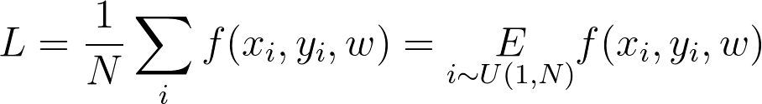
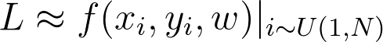
Stochastic gradient descent
Approximate objective with samples
sgd
gd

Slide 46
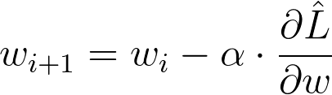
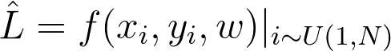
Stochastic gradient descent
Approximate objective with samples
Update:
sgd
gd
where

Slide 47
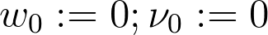
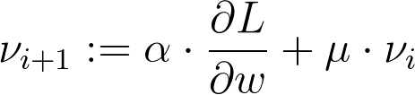
SGD with momentum
Idea: average gradient over consecutive steps
aka “add inertia”

Slide 48
SGD with momentum
Idea: average gradient over consecutive steps
aka “add inertia”
// reuse gradient from
previous steps

Slide 49
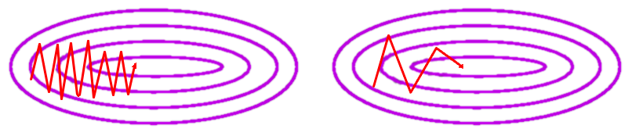
SGD with momentum
Idea: average gradient over consecutive steps
(see this demo)

Slide 50
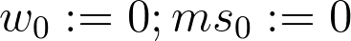
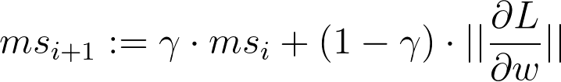
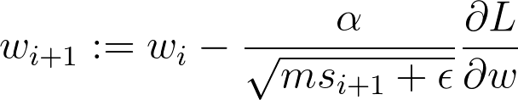
RMSProp
Idea: adapt learning rate to the slope of objective function large gradient = go slower, small gradient = go faster

Slide 51
RMSProp
Idea: adapt learning rate to the slope of objective function large gradient = go slower, small gradient = go faster
moving average norm^2

Slide 52
Adam
Idea: combine momentum and rmsprop in one method the “default” optimizer, see the paper for details
moving average norm^2

Slide 53
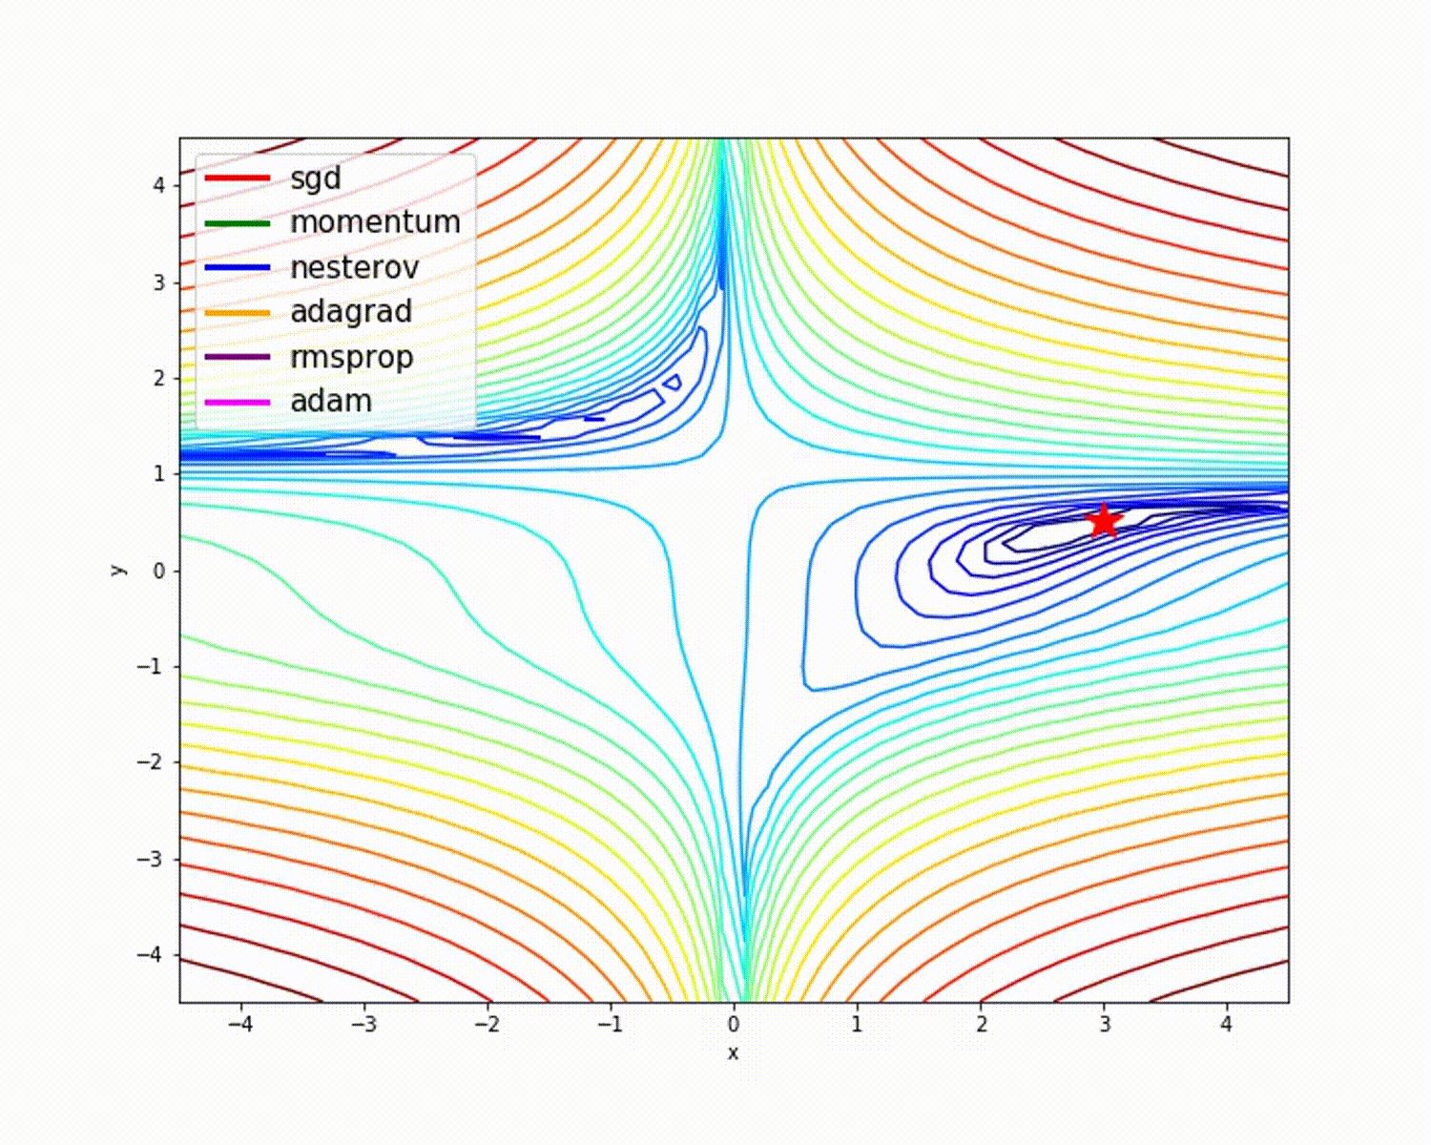
TL;DR stochastic optimization
Tips & tricks
Adam works fine out of the box
One can usually beat adam with tuned sgd+momentum
Tuning may take long
Everyone has his favorite optimizer :)

Slide 54
Stuff we won’t cover
First order
Adam flavors: NAdam, Adamax, QHAdam
Adagrad, Radagrad, Adadelta - alternative adaptive lr
Approx second order
BFGS, L-BFGS
K-FAC

Slide 55
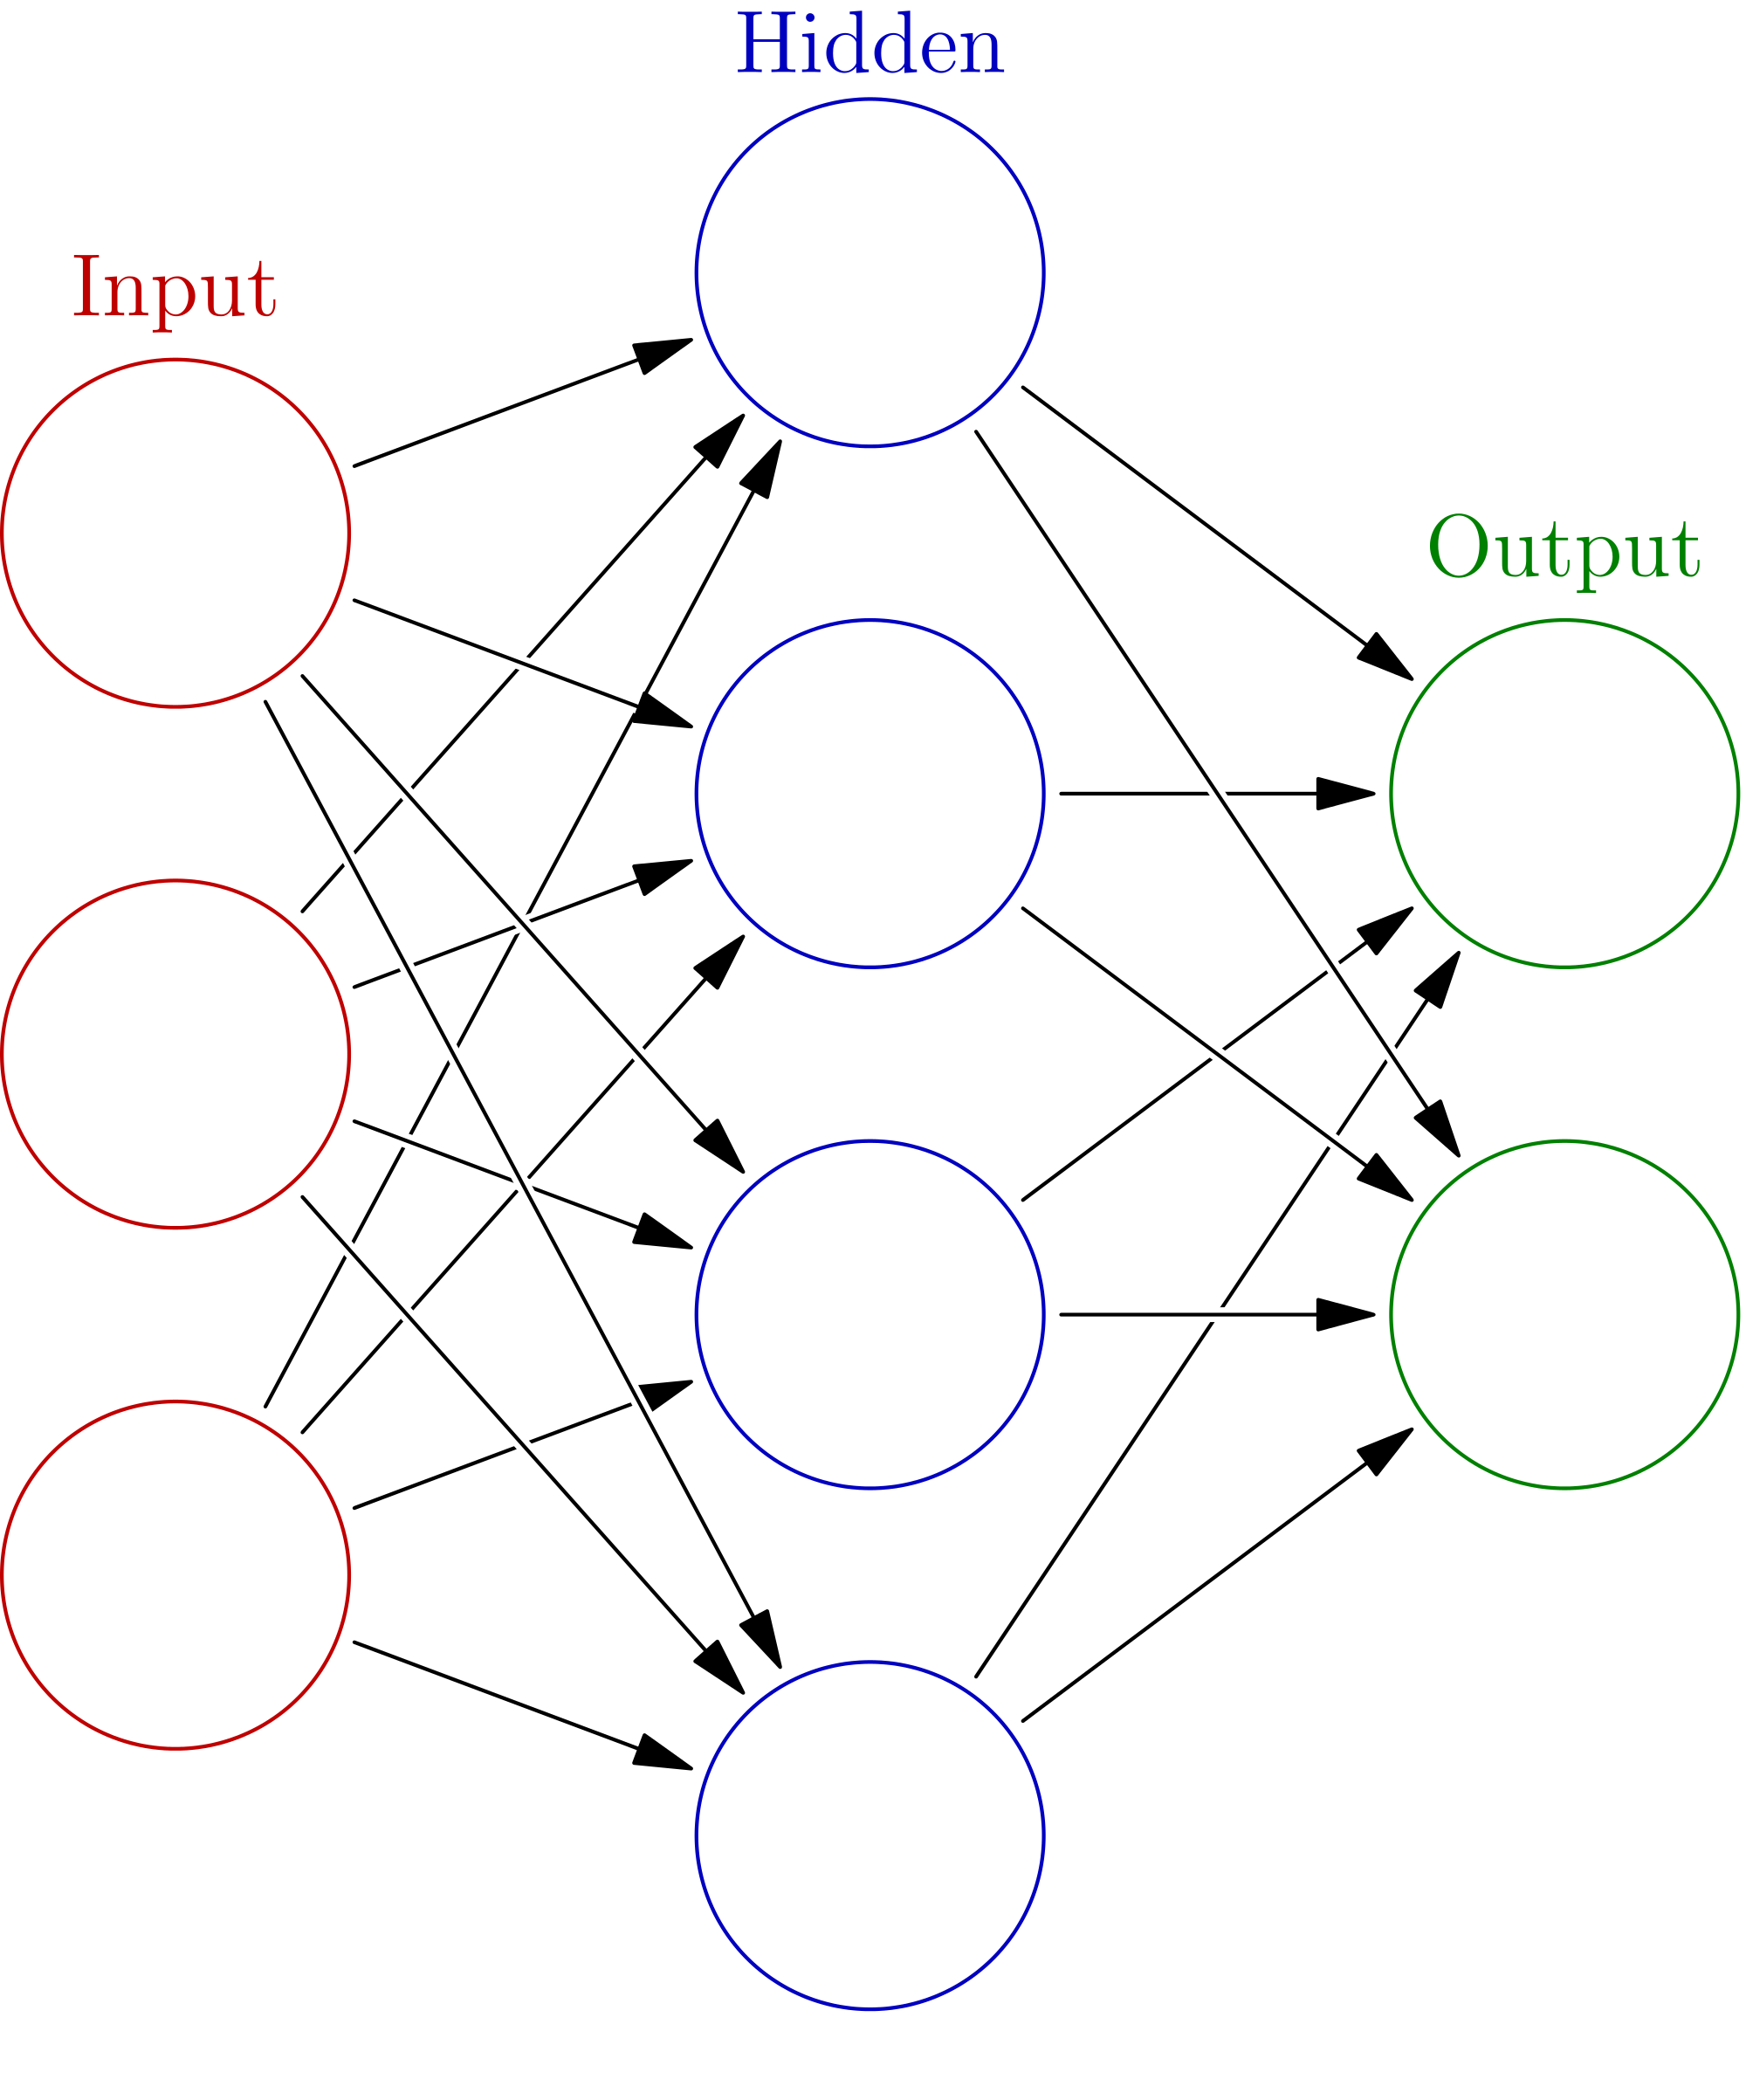
Initialization, symmetry problem
h0
Initialize with zeros
W := 0
What will the first step look like?
x0
h1
y0
x1
h2
y1
h2
x2
h3

Slide 56
Initialization, symmetry problem
Break the symmetry!
Initialize with random numbers!
W := N(0,0.01)?
W := U(-0.1,0.1)?
read more
h0
x0
h1
y0
x1
h2
y1
h2
x2
h3

Slide 57

Nuff said
Let's go implement that!

Slide 58
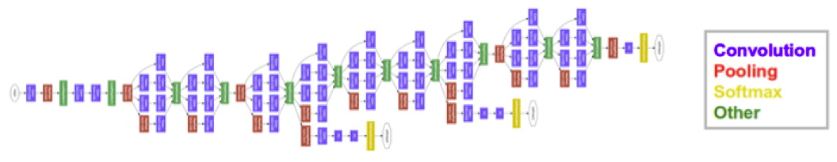
And now let's differentiate
near state-of-the-art in image classification
5+ types of layers
parallel branches with independent losses
few hundred megabytes of weights

Slide 59

And now let's differentiate
near state-of-the-art in image classification
5+ types of layers
parallel branches with independent losses
few hundred megabytes of weights

Slide 60
Deep learning frameworks
near state-of-the-art in image classification
5+ types of layers
parallel branches with independent losses
few hundred megabytes of weights

Slide 61
Deep learning frameworks
Core idea: helps you define and train neural nets
Keras, Lasagne, Pyro
& many more
High-level
Caffe, Theano, TF, Torch, ...
Low-level libraries
CUDNN, cuSparse, ...
Low-level
CUDAC++, CUDA*
Low-level
CUDAC++, CUDA*
Hardware
(CPU/GPU/TPU/FPGA)

Slide 62
Deep learning frameworks
Core idea: helps you define and train neural nets
We'll spend next K slides here
Keras, Lasagne, Slim
& many more
High-level
Caffe, Theano, TF, Torch,...
Low-level libraries
CUDNN
Low-level
CUDAC++, CUDA*
Low-level
CUDAC++, CUDA*
Hardware
(CPU/GPU/TPU/FPGA)

Slide 63
Deep learning frameworks
Layer-based frameworks:
Same idea as in our hand-made neural net

Slide 64
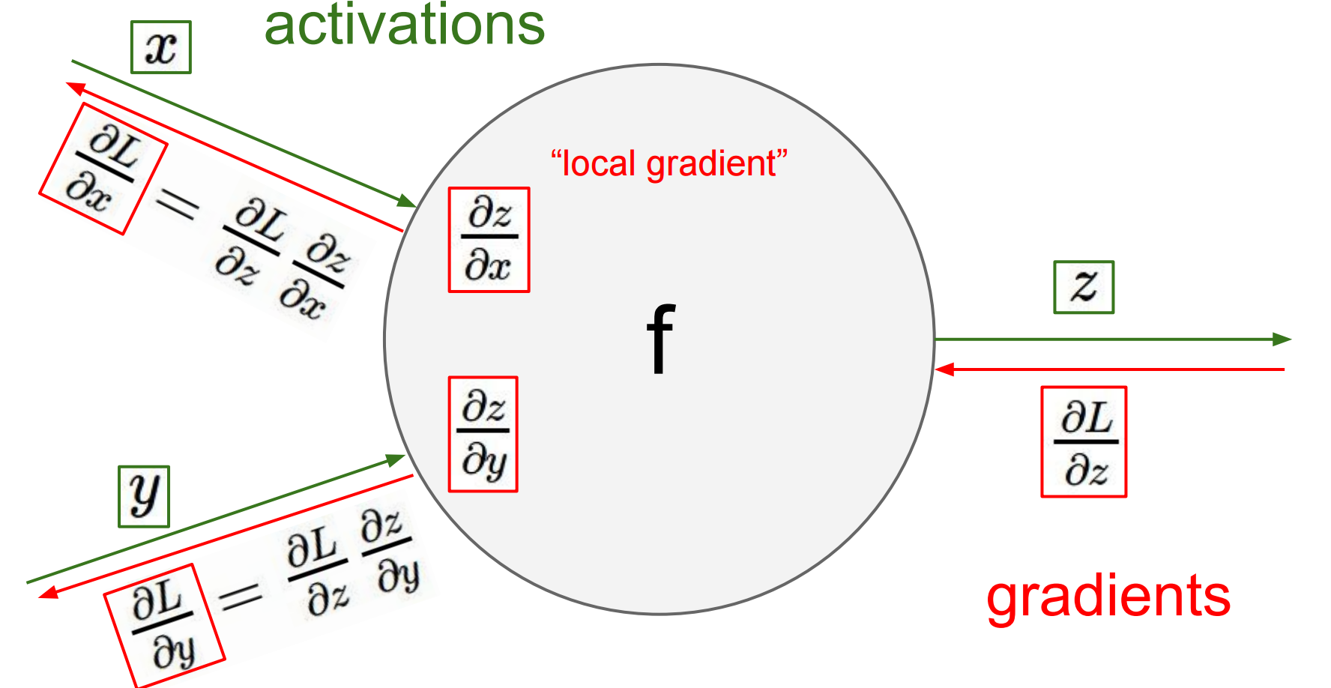

Deep learning frameworks
Layer-based frameworks:
Same idea as in our hand-made neural net
this one - http://bit.ly/2w9kAHm
Layer

Slide 65

Deep learning frameworks
name: "LeNet"
layer {
name: "conv1"
type: "Convolution"
bottom: "data"
top: "conv1"
param {lr_mult: 1}
param {lr_mult: 2}
convolution_param {
num_output: 20
kernel_size: 5
stride: 1
weight_filler {
type: "xavier"
}}}
….
You define model in config file by stacking layers (left)
Then run train script:
caffe train -solver examples/mnist/lenet_solver.prototxt
130 lines

Slide 66
Deep learning frameworks
name: "LeNet"
layer {
name: "conv1"
type: "Convolution"
bottom: "data"
top: "conv1"
param {lr_mult: 1}
param {lr_mult: 2}
convolution_param {
num_output: 20
kernel_size: 5
stride: 1
weight_filler {
type: "xavier"
}}}
….
+ Easy to deploy (C++)
+ A lot of pre-trained models
(model zoo)
- Model as protobuf
- Hard to build new layers
- Hard to debug
Still used for computer vision
130 lines

Slide 67
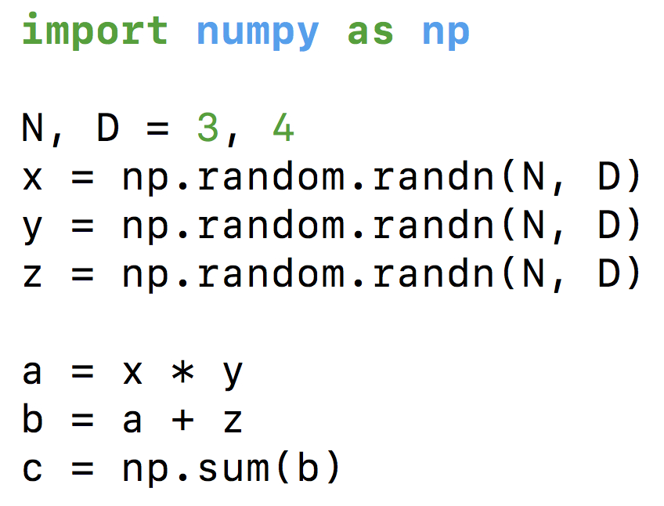
Computation graphs
What does your CPU do
when you write this?
This many further slides taken from Ars Ashukha @deepbayes2017

Slide 68
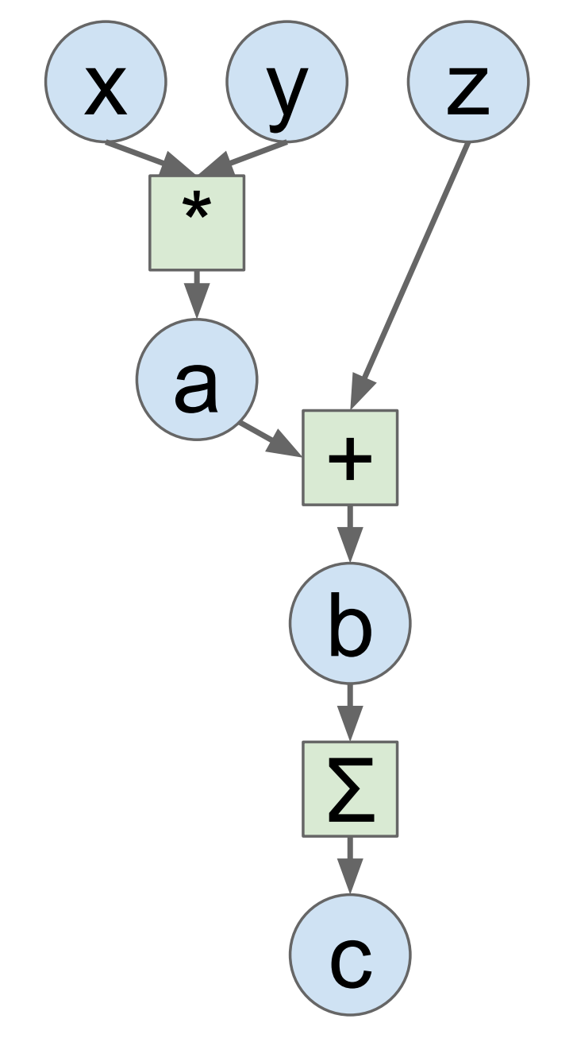
Computation graphs
Idea: let's define this graph explicitly!
This many further slides taken from Ars Ashukha @deepbayes2017

Slide 69

Computation graphs
+ Automatic gradients!
+ Easy to build new layers
+ We can optimize the Graph
- Graph is static during training
- Need time to compile/optimize
- Hard to debug
Grads
This many further slides taken from Ars Ashukha @deepbayes2017

Slide 70

Dynamic graphs
Chainer, DyNet, Pytorch

Slide 71


Dynamic graphs
Chainer, DyNet, Pytorch
+ Can change graph on the fly
+ Can get value of any tensor at any time
(easy debugging)
- Hard to optimize graphs
(especially large graphs)
- Still early development
Researchers love these!

Slide 72

Dynamic graphs
Researchers love them!

